Slide 1








Keeping safe online
Click through each slide

Slide 2
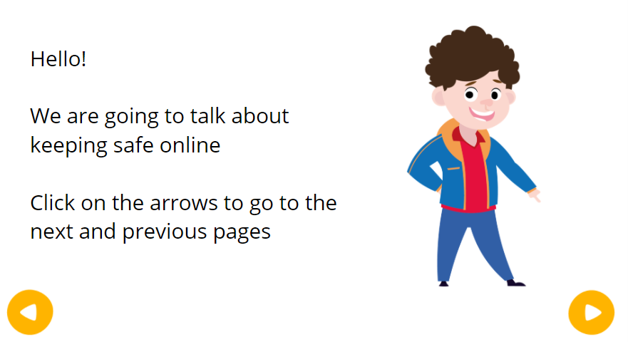

Click for the next slide

Slide 3
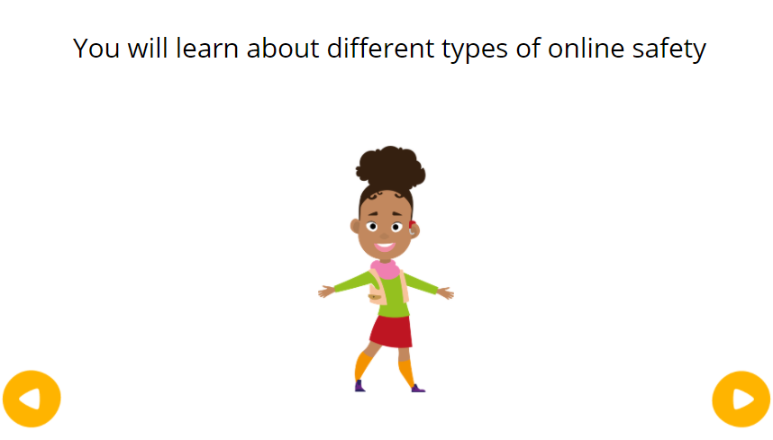
Click for the next slide

Slide 4
Lets look at passwords
Click for the next slide

Slide 5
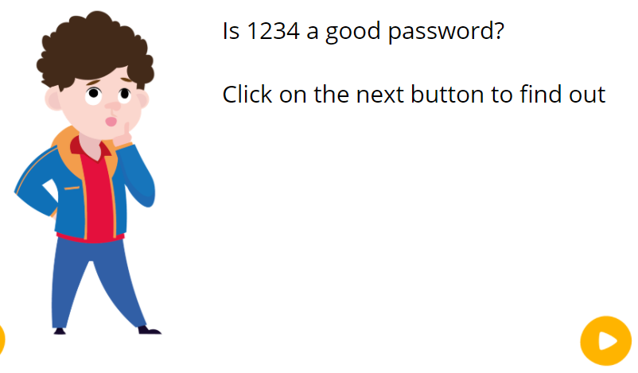

Click for the next slide to find out

Slide 6
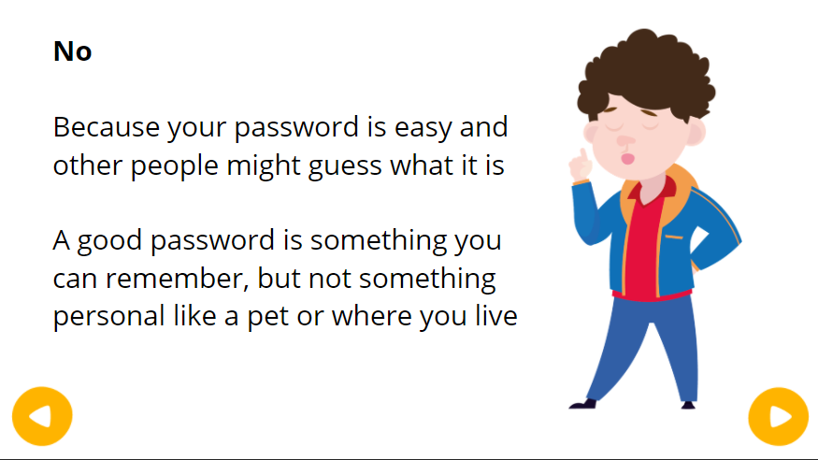
Click for the next slide

Slide 7
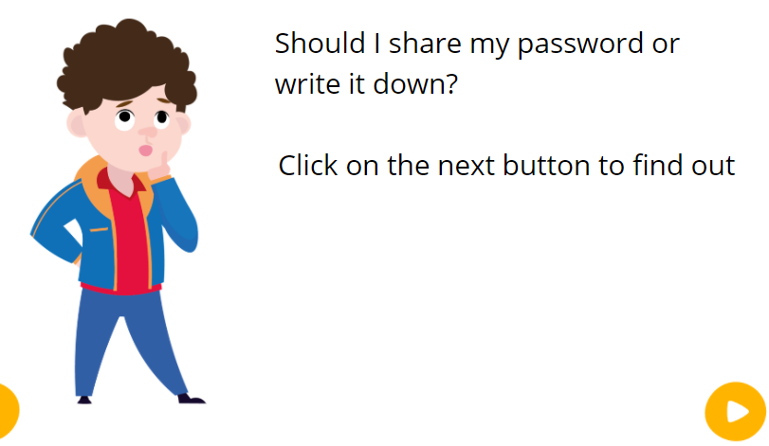
Click for the next slide to find out

Slide 8
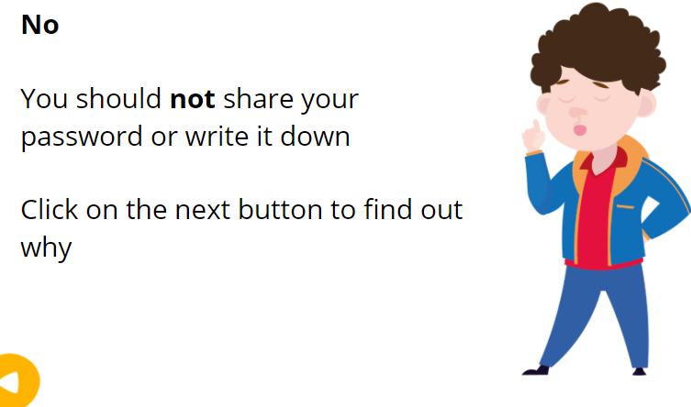
Click for the next slide

Slide 9
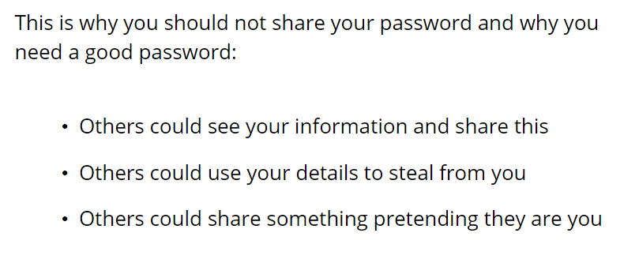
Click for the next slide

Slide 10

Click for the next slide

Slide 11
Lets talk about sharing personal information
Click for the next slide

Slide 12
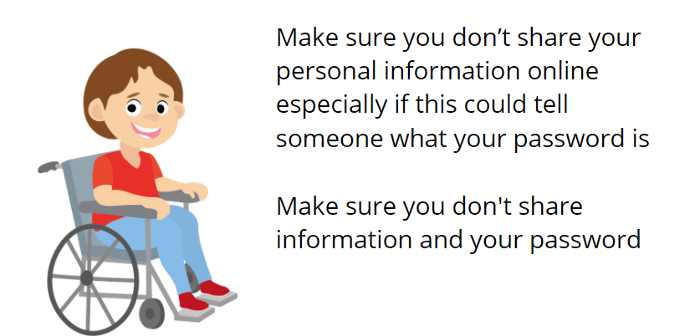
Click for the next slide

Slide 13
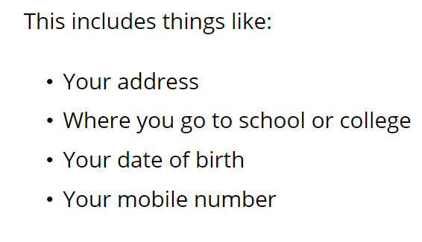
Click for the next slide

Slide 14
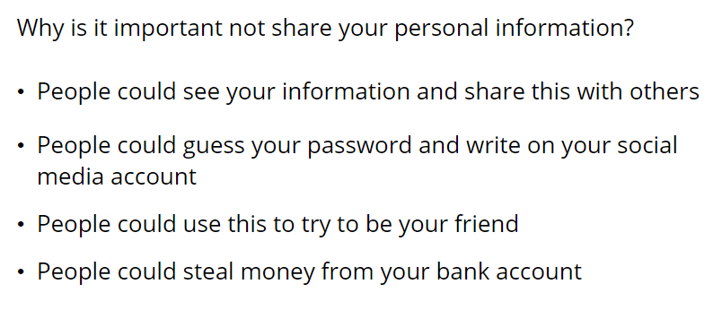
Click for the next slide

Slide 15

Click for the next slide

Slide 16
Lets talk about banter
Click for the next slide

Slide 17
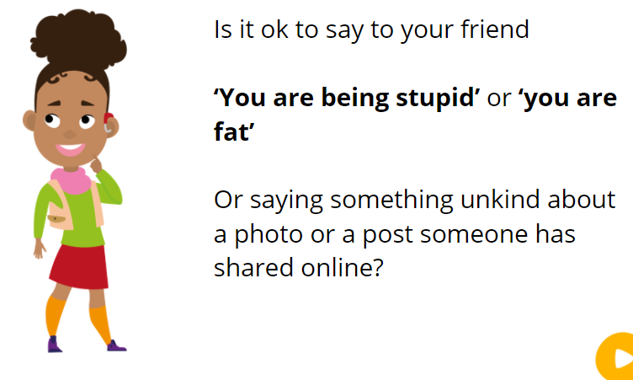
Click for the next slide to find out

Slide 18
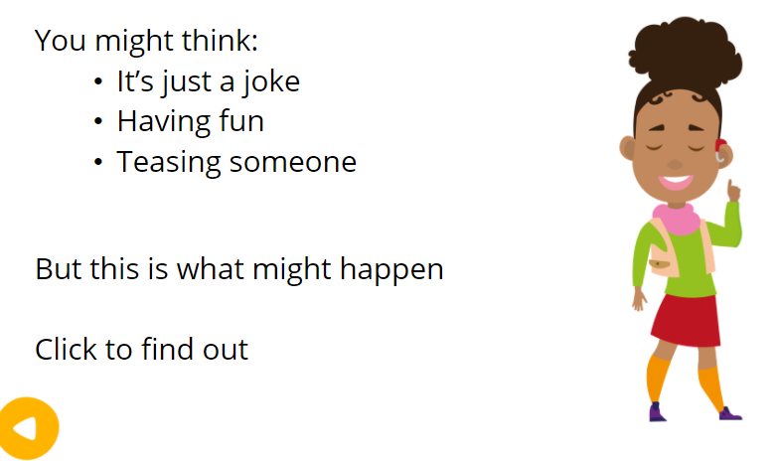
Click for the next slide to find out

Slide 19
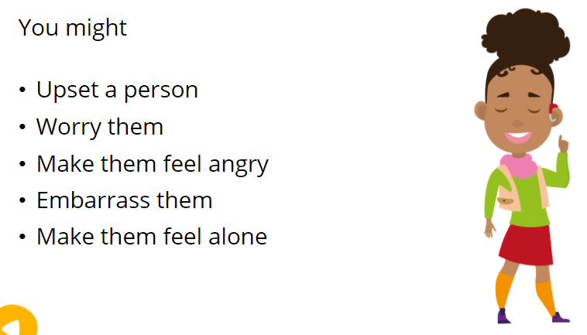
Click for the next slide

Slide 20
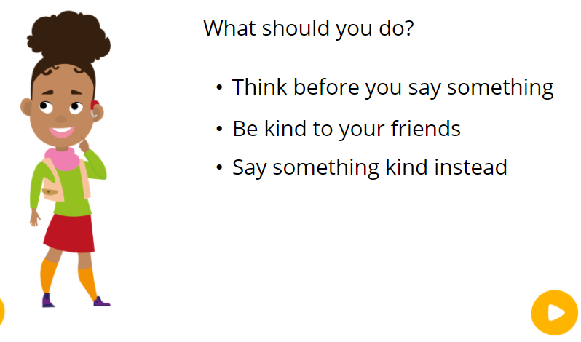
Click for the next slide

Slide 21

Click for the next slide

Slide 22
Lets talk about bullying online
Click for the next slide

Slide 23
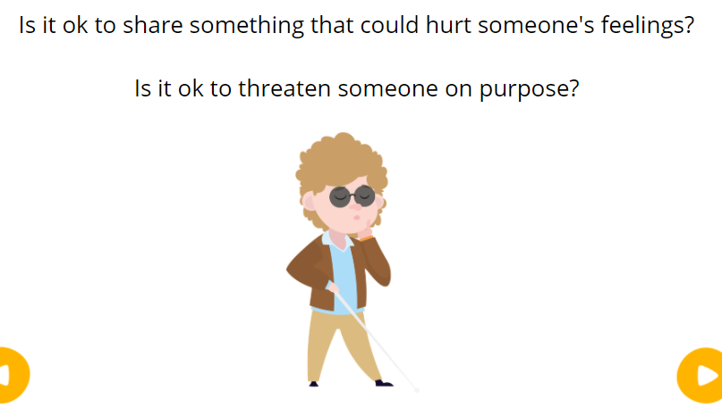
Click for the next slide to find out

Slide 24
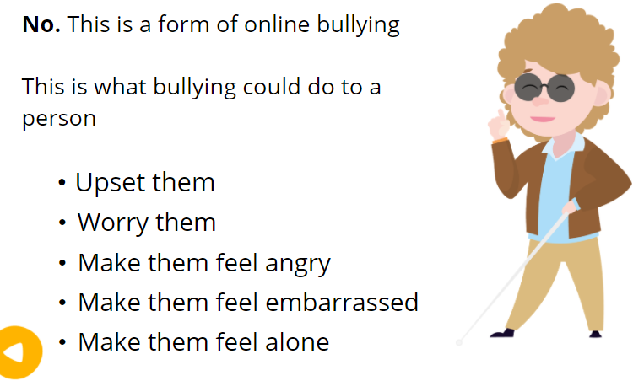
Click for the next slide

Slide 25
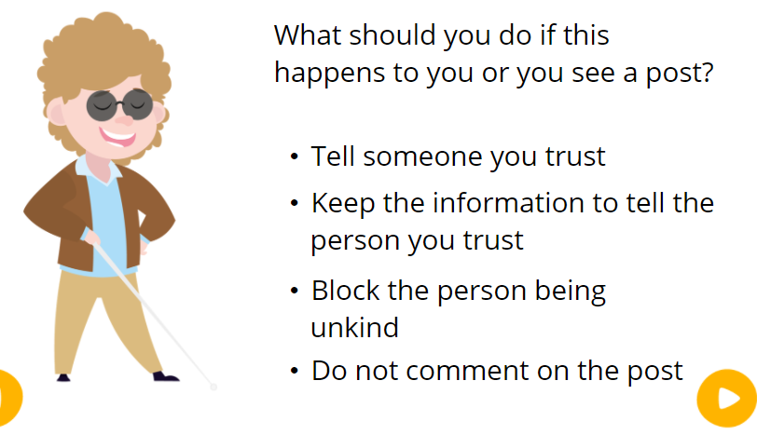
Click for the next slide

Slide 26

Click for the next slide

Slide 27
Lets look at talking to people online
Click for the next slide

Slide 28
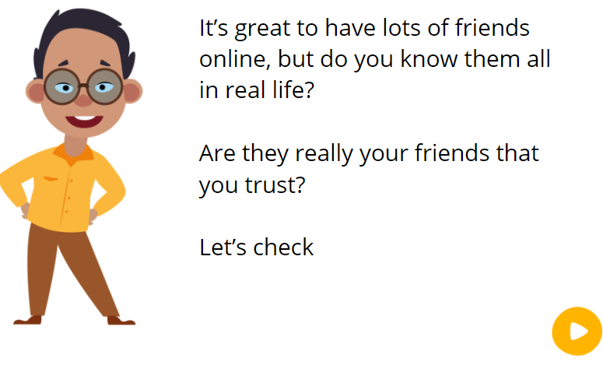
Click for the next slide find out

Slide 29
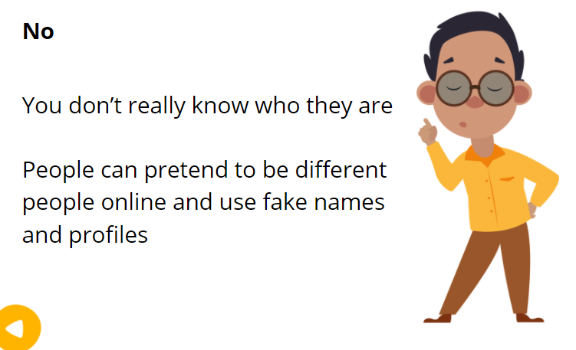
Click for the next slide

Slide 30
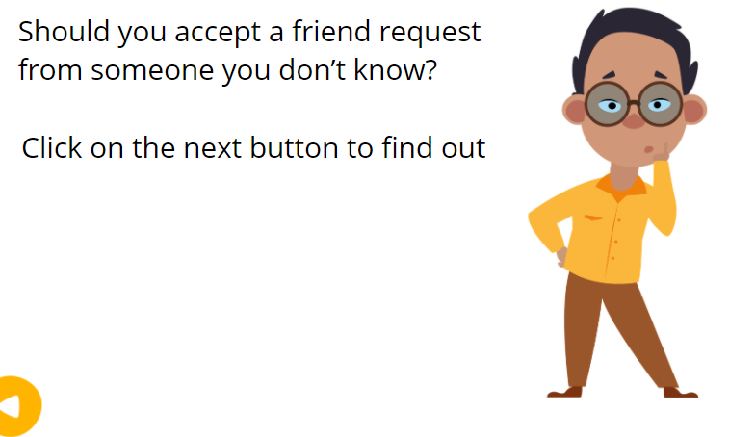
Click for the next slide to find out

Slide 31
Click for the next slide

Slide 32
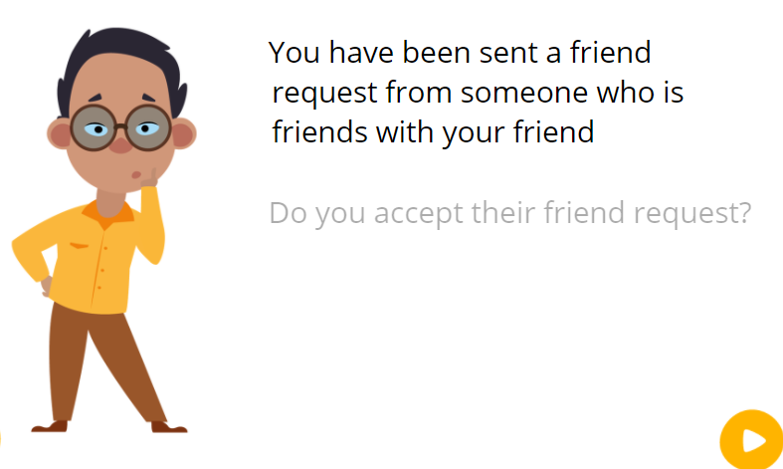
Do you accept their friend request?
Click for the next slide to find out

Slide 33
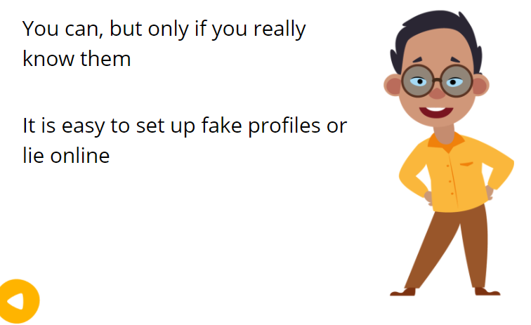
Click for the next slide

Slide 34
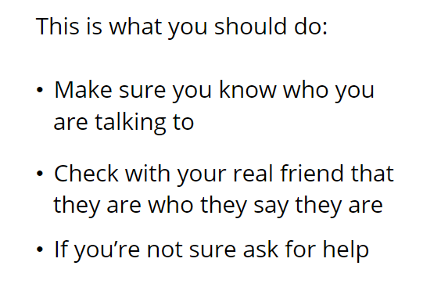
Click for the next slide

Slide 35
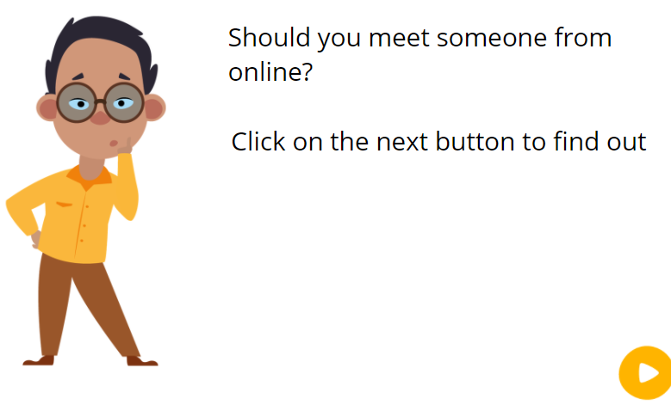
Click for the next slide to find out

Slide 36
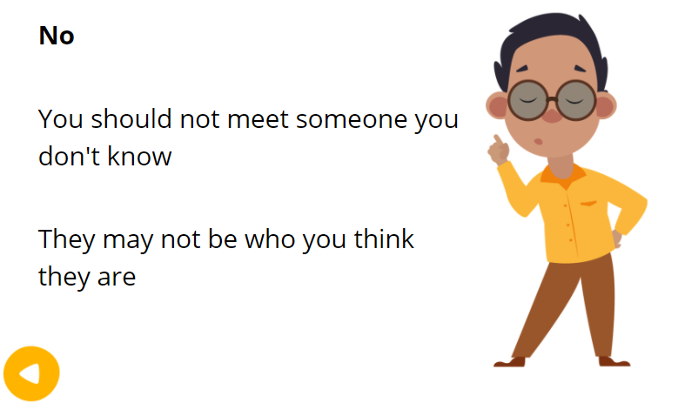
Click for the next slide

Slide 37
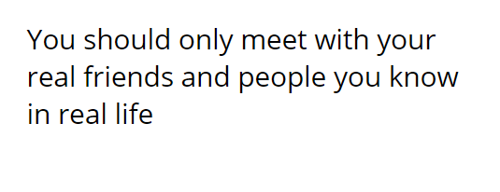
Click for the next slide

Slide 38

Click for the next slide

Slide 39
Lets talk about sharing feelings online
Click for the next slide

Slide 40
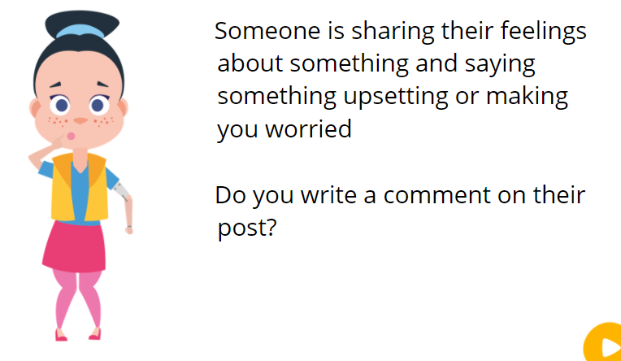
Click for the next slide to find out

Slide 41
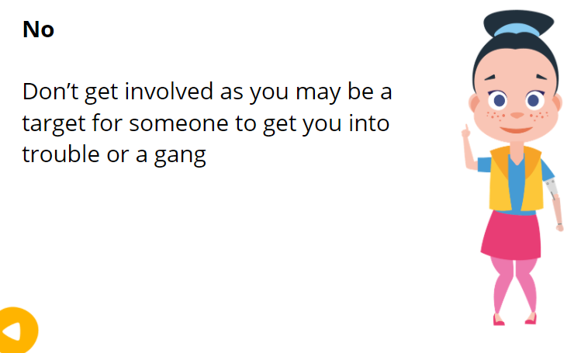
Click for the next slide

Slide 42
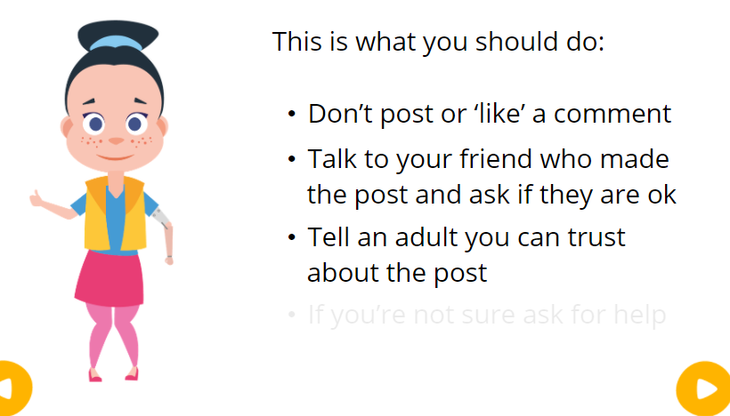
Click for the next slide

Slide 43

Click for the next slide

Slide 44
Click for the next slide

Slide 45
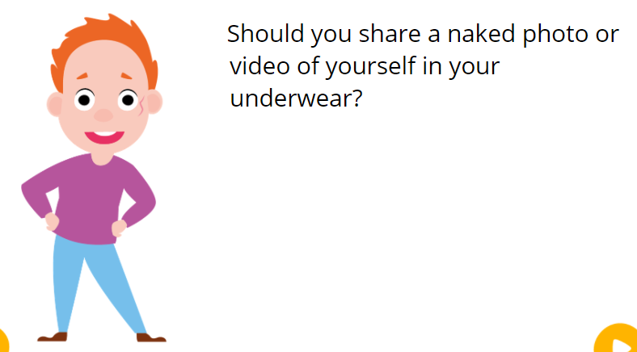
Click for the next slide to find out

Slide 46
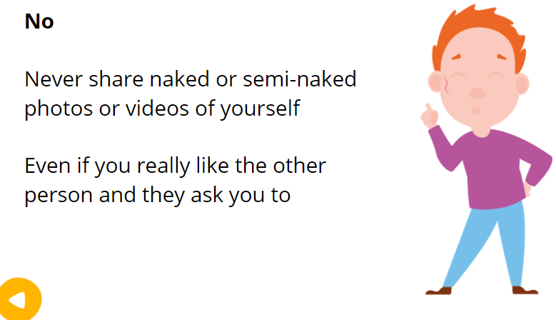
Click for the next slide

Slide 47
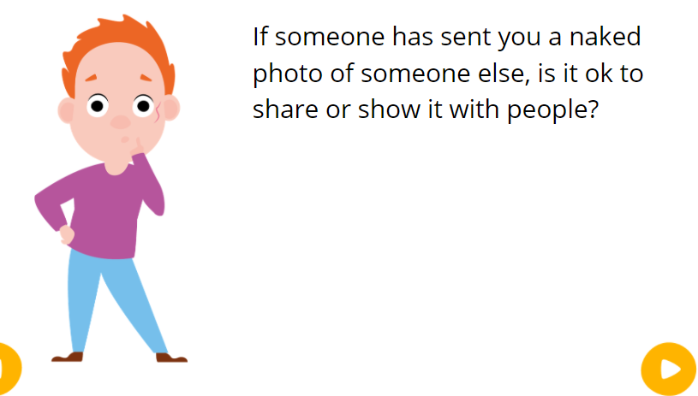
Click for the next slide to find out

Slide 48
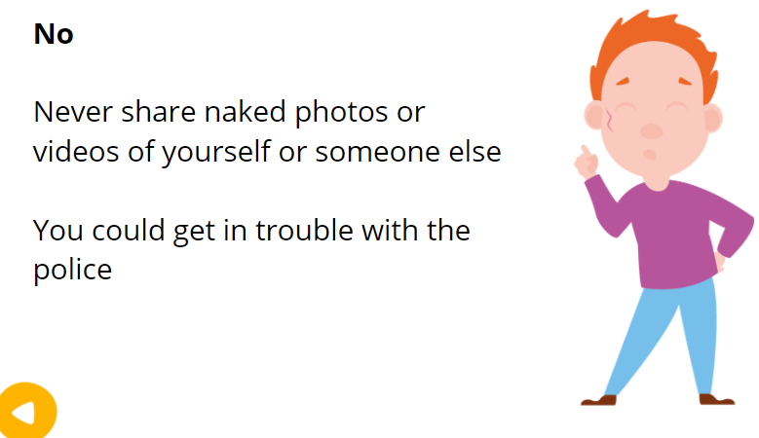
Click for the next slide

Slide 49
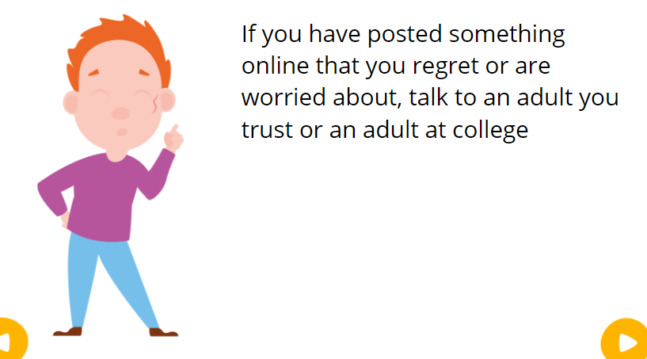
Click for the next slide

Slide 50

Click for the next slide

Slide 51


Click for the next slide

Slide 52
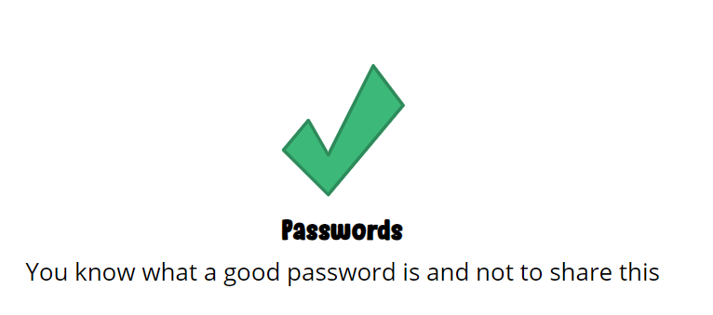
Click for the next slide

Slide 53

Click for the next slide

Slide 54
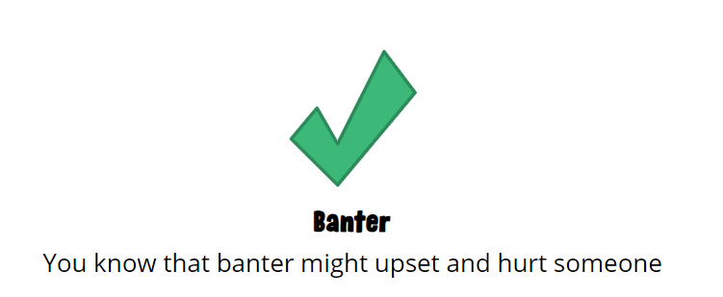
Click for the next slide

Slide 55
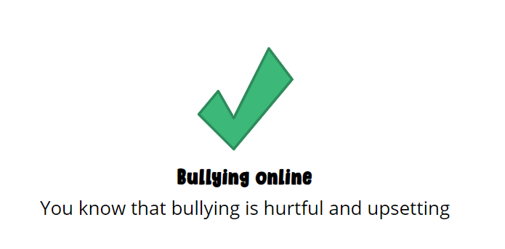
Click for the next slide

Slide 56
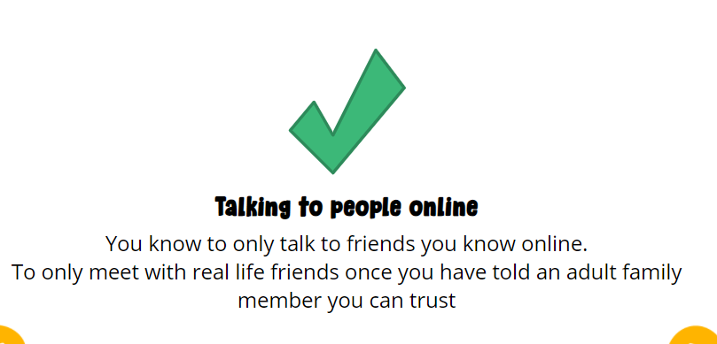
Click for the next slide

Slide 57
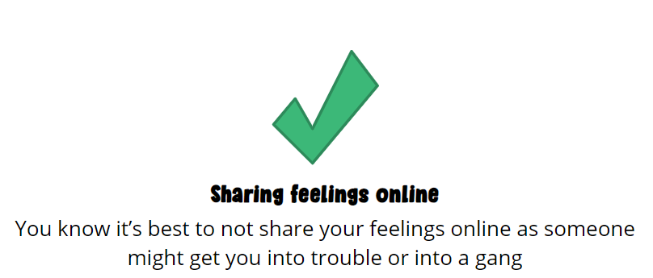
Click for the next slide

Slide 58
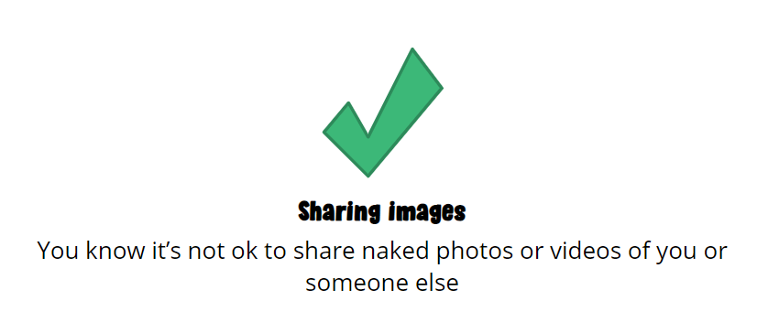
Click for the next slide

Slide 59

Click for the next slide

Slide 60
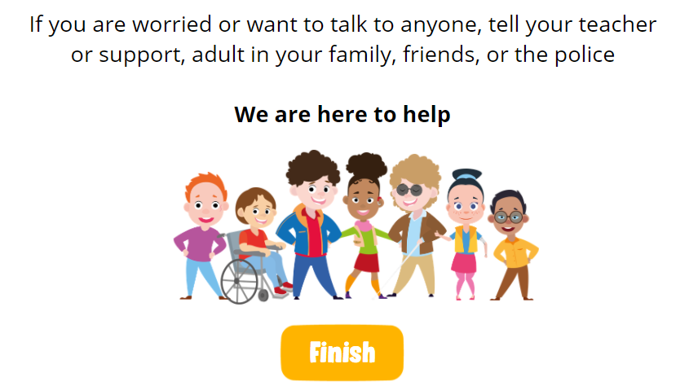
We are here to help

